Slide 1
A project report on
Data analysis and visualization of New York Yellow Taxi Trip data, by using BigData Technologies and Tableau.
BY
Group No. 23
Mr Mayur Chaudhari 200244525016
Mr Bhavesh Sawant 200244525007
Mr Nilesh Singal 200244525022
Mr Mangesh Hande 200244525015
Mr Dheerajkumar Deore 200244525009
Project Mentor
Mr Amar Walke

Slide 2
Description :
Data analysis and visualization of New York Yellow Taxi Trip data, The core objective of this is to find the most pickups, drop-offs of public based on their location, time of most traffic and how to overcome the needs of the public, by using BigData Technologies and Tableau.

Slide 3
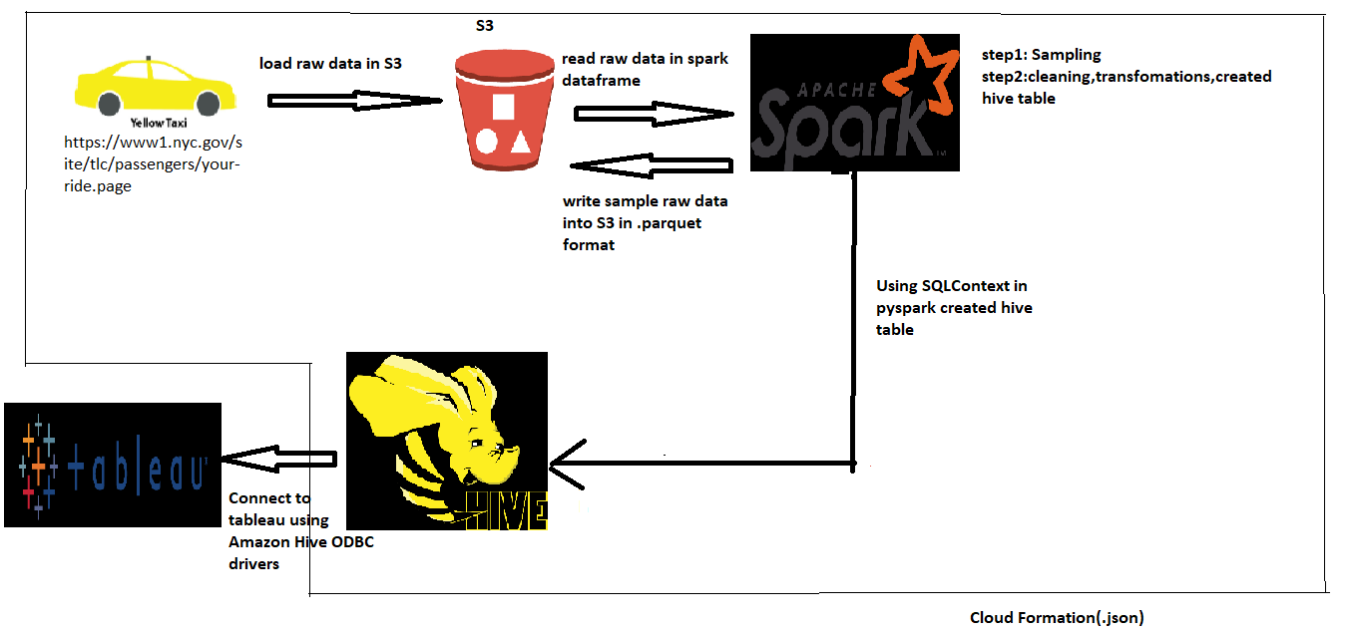
Architecture Diagram:

Slide 4
Challenges :
Data searching and gathering from internet
To process bigdata (30Gb)
  Slow query performance
  Time consuming
  File format (csv, xlsx)
Creating hive table as per the problem statements
Emr steps
CloudFormation
Loading data in Tableau (Poor Query Execution Low)
Even after random sampling, tableau Query performance was still low(it was consuming more time to execute)

Slide 5
Team Member Role:
Mayur Chaudhari :
  data ingestion through s3 to pyspark
  CSV to Parquet / ORC
  architecture Diagram
  sampling, cleaning, transformation
  clean data upload to s3 bucket in orc format
  created table in hive using clean data
  CFT, EMR steps
Bhavesh Sawant:
  Understanding domain knowledge of data
  Generating Question out of data
  connecting tableau to EMR Hive through ODBC Driver
  Visualizations And Dashboards in Tableau

Slide 6
Team Member Role:
Mangesh Hande:
  data ingestion through s3 to pyspark
  csv to parquet
  architecture Diagram
  sampling, cleaning, transformation
  clean data upload to s3 bucket in ORC format
  created table in hive using clean data
  CFT, EMR steps
Nilesh Singal:
  Data Gathering
  Understanding domain knowledge of data
  cleaning ,Filtering and EDA in Spark
  CFT, EMR Steps

Slide 7
Team Member Role:
Dheerajkumar Deore:
  Data searching/Data Gathering
  Understanding domain knowledge of data
  hadoop data ingestion
  S3 data ingestion
  Visualizations And Dashboards in Tableau
  connecting tableau to EMR Hive through ODBC Driver

